Slide 1
DIFFERENCE IN HAART TREATMENT RESPONSE IN PATIENTS USING HARD DRUGS AND THOSE WHO DID NOT REPORT USING HARD DRUGS AT BASELINE
BRIDGET BALKARAN
BIOS 6623 PROJECT 1
INTERIM PRESENTATION

Slide 2
DESCRIPTIVE STATISTICS
VARIABLE | N | MEAN | STANDARD DEVIATION | MISSING
Viral Load Difference | 487 | -1000415.39 | 1.13e7 | 228
CD4+ T Cells Difference | 478 | 169.29 | 1.83.54 | 228
Mental Health Score Difference | 499 | 2.21 | 11.99 | 216
Physical Health Score Difference | 499 | -1.64 | 8.44 | 216
DISTRIBUTION OF VIRAL LOAD DIFFERENCE IS LEFT SKEWED – MAY NEED TO BE TRANSFORMED
MANY MISSING VALUES - ANALYZE DISTRIBUTION OF MISSING VALUES

Slide 3
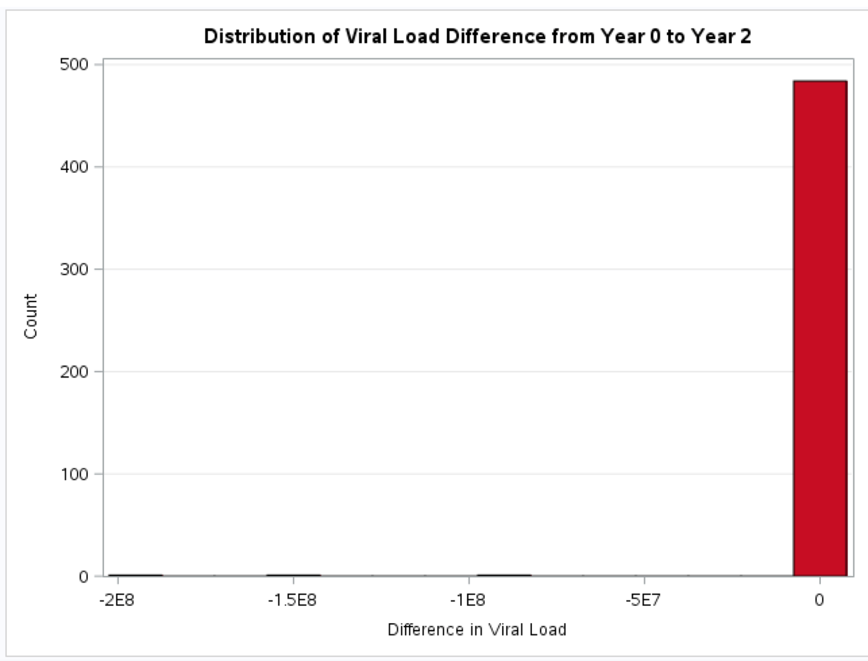
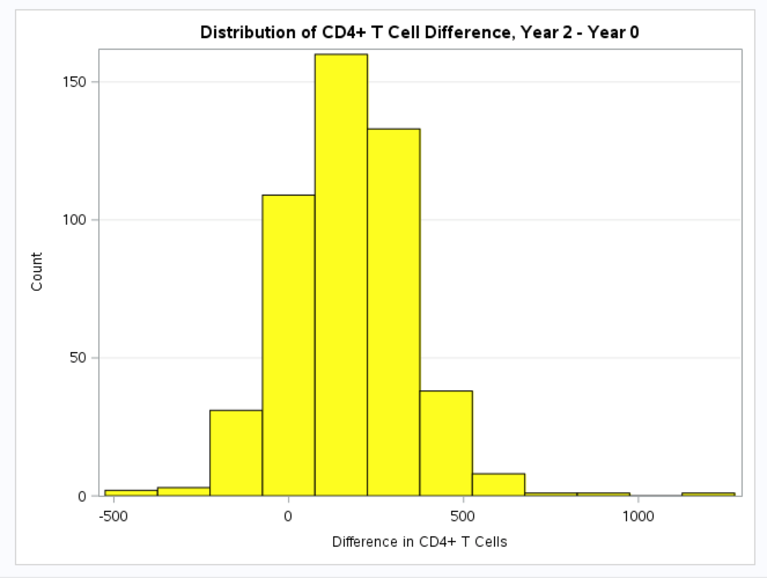
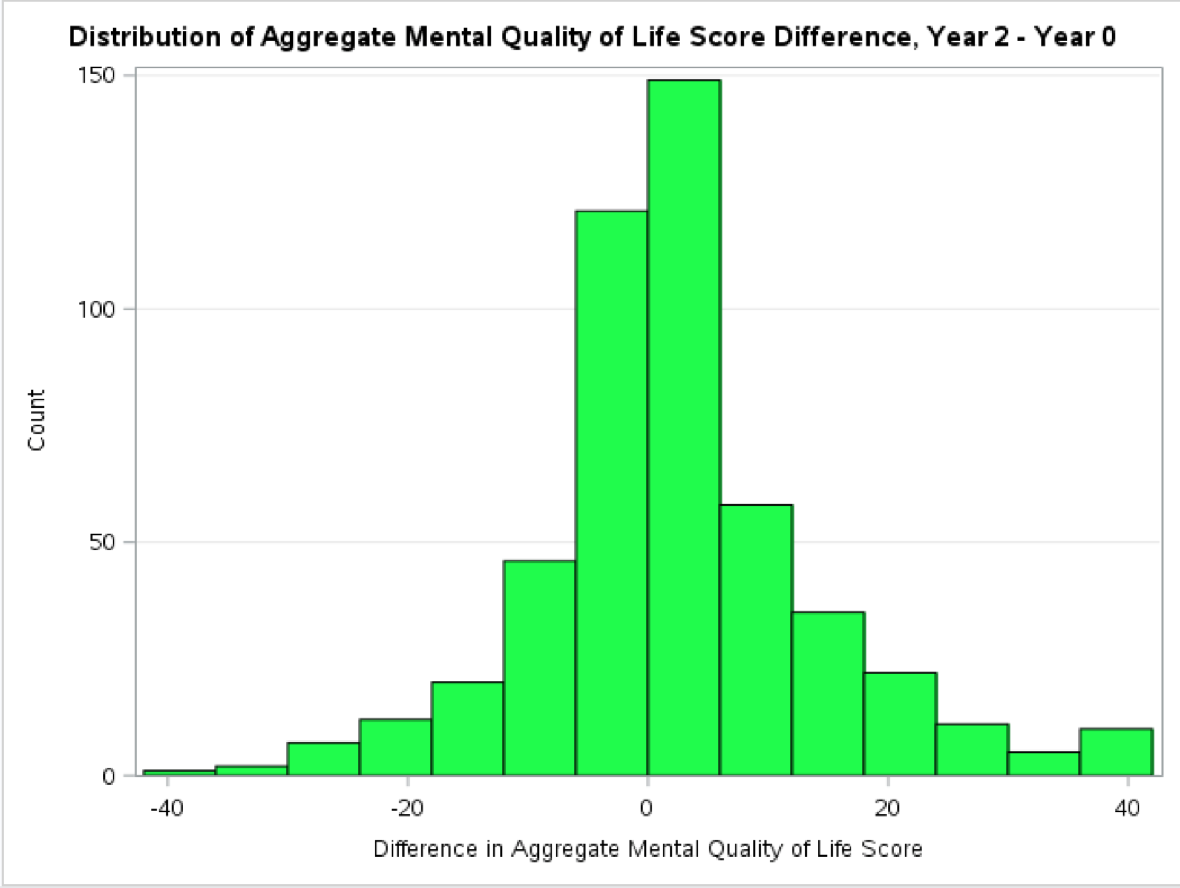
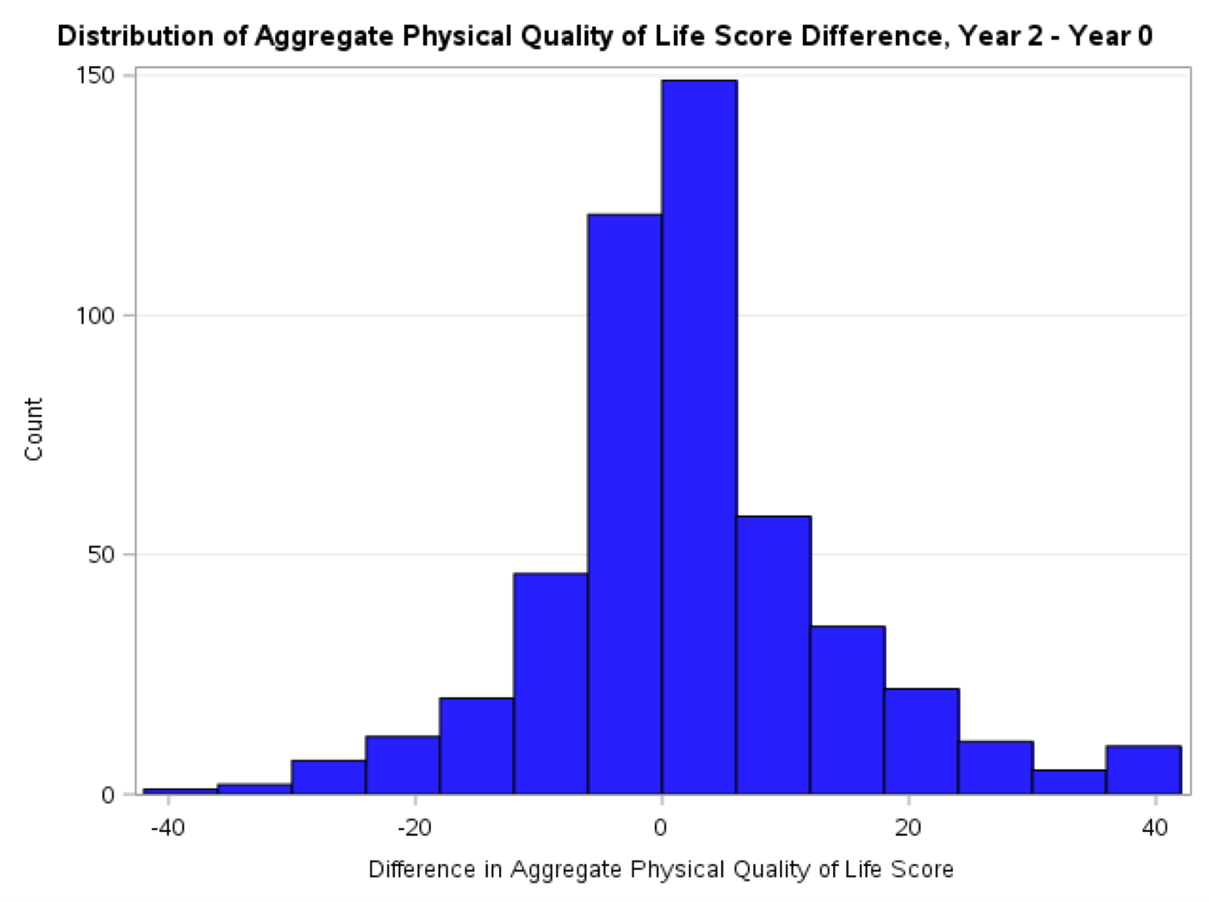
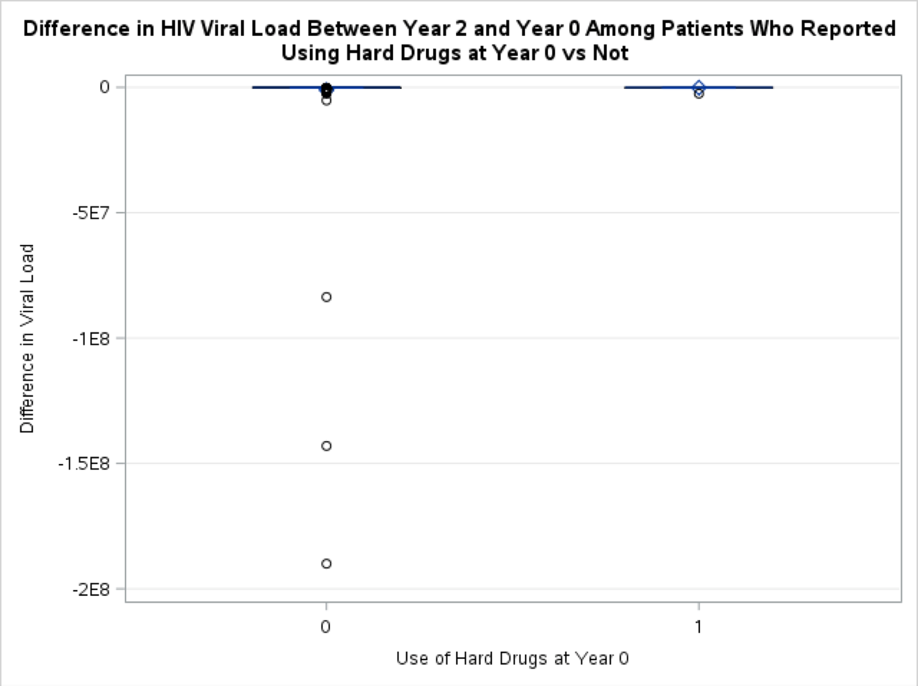
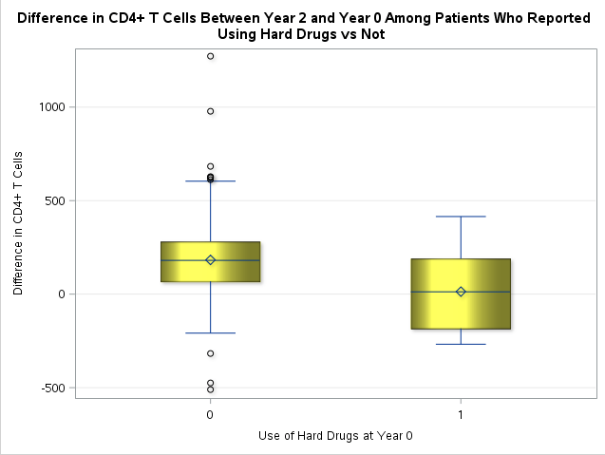
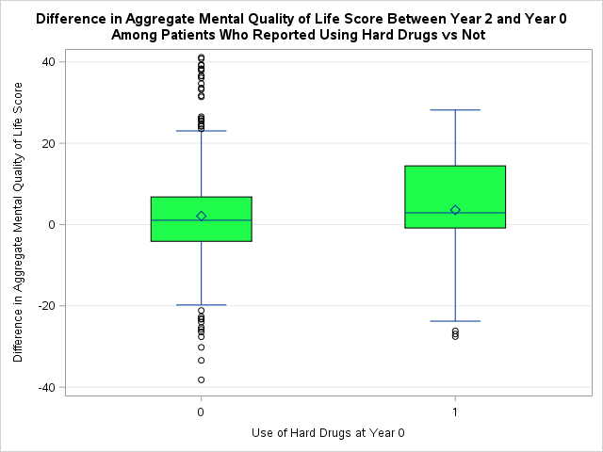
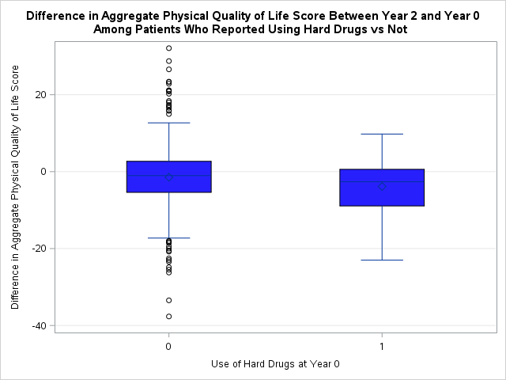
Aggregate Mental QOL Score
Aggregate Physical QOL Score
Viral Load Difference
CD4+ T Cell Difference

Slide 4
ANALYSIS PLAN
TRANSFORM DATA FOR VIRAL LOAD DIFFERENCE
ANALYZE MISSING DATA
CORRELATION ANALYSIS
FOUR ANALYSES
UNIVARIATE ANALYSIS, ADJUSTING FOR BASELINE VALUES
MULTIVARIATE ANALYSIS, ADJUSTING FOR IMPORTANT COVARIATES AND POSSIBLE CONFOUNDERS AND INTERACTIONS
FINAL MODELS

